Slide 1
Tutorial 5 new

Slide 2

Q1
Design a divide-and-conquer algorithm for the following problem. Analyze the time complexity for your algorithm.
Input: An integer $x$ and an $m×n$ integer matrix $M$ such that $M_{i,j}<M_{i+1,j}$ and $M_{i,j}<M_{i,j+1}$ for all $i$ and $j$.
Question: Is $x$ is an element in $M$?

Slide 3
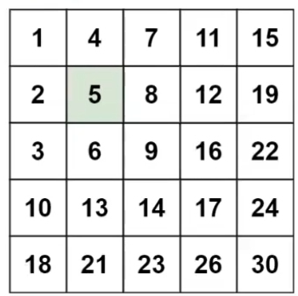
Think
Elements in this part are always smaller than 5.
Elements in this part are always bigger than 5

Slide 4

Q2.
Illustrate the following two polynomials using divide and conquer PolyMulti algorithm:
$$A=2+x+4x^{2}+3x^{3}$$
$$B=3+5x+2x^{2}+x^{3}$$

Slide 5
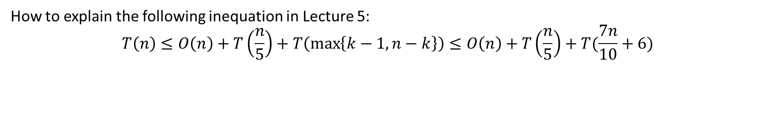
Q3
How to explain the following inequation in Lecture 5:
$$T\left(n\right)≤O\left(n\right)+T\left(\frac{n}{5}\right)+T\left(\max\left\{k−1,n−k\right\}\right)≤O\left(n\right)+T\left(\frac{n}{5}\right)+T(\frac{7n}{10}+6)$$
medians
S

Slide 6
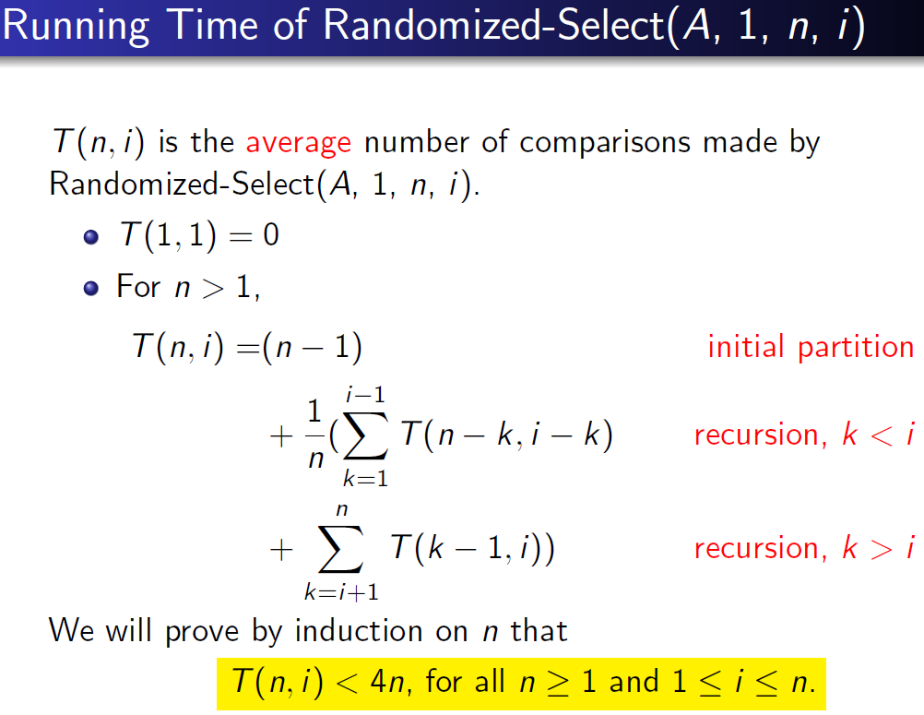
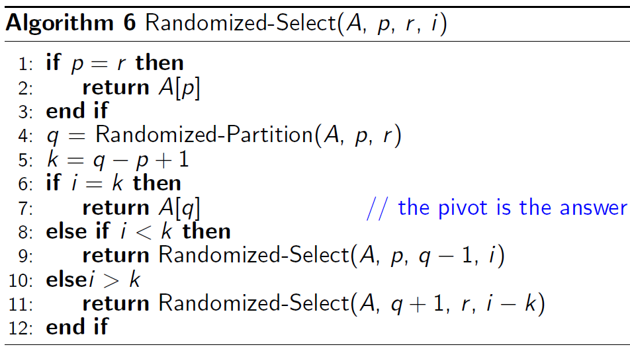
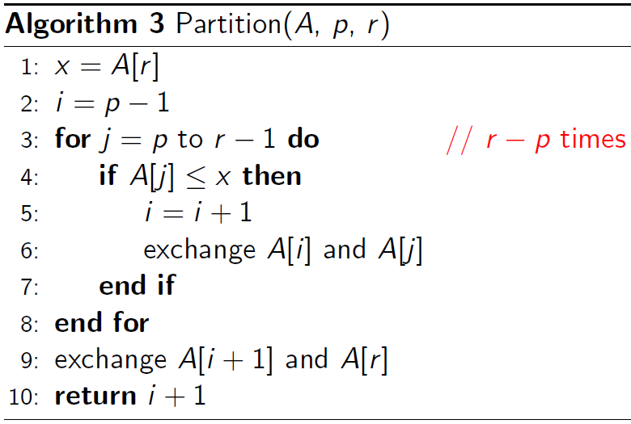
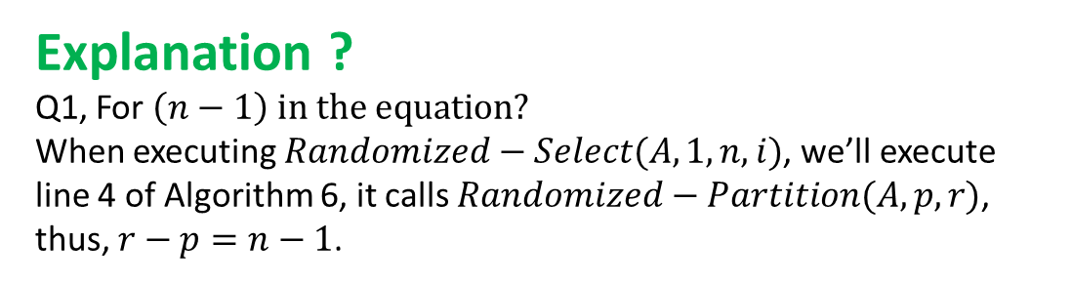
Q4. Random Selection
Explanation ?
Q1, For $\left(n−1\right)$ $in the equation?$
When executing $Randomized−Select(A,1,n,i)$, we’ll execute line 4 of Algorithm 6, it calls $Randomized−Partition(A,p,r)$, thus, $r−p=n−1$.

Slide 7
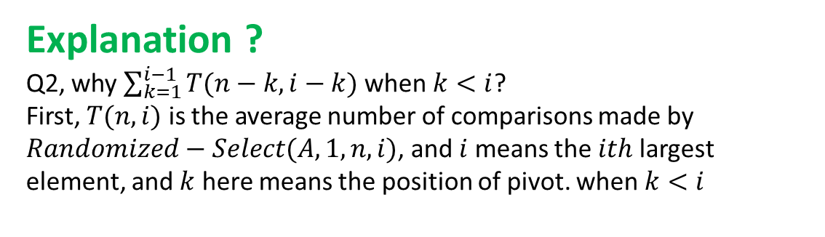
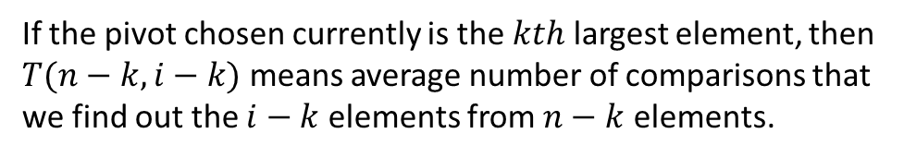

Random Selection
Explanation ?
Q2, why $\sum_{k=1}^{i−1}{T(n−k,i−k)}$ when $k<i$?
First, $T(n,i)$ is the average number of comparisons made by $Randomized−Select(A,1,n,i)$, and $i$ means the $ith$ largest element, and $k$ here means the position of pivot. when $k<i$
Postion: $1$ $k$ (Pivot) $i$ $n$
If the pivot chosen currently is the $kth$ largest element, then $T(n−k,i−k)$ means average number of comparisons that we find out the $i−k$ elements from $n−k$ elements.

Slide 8
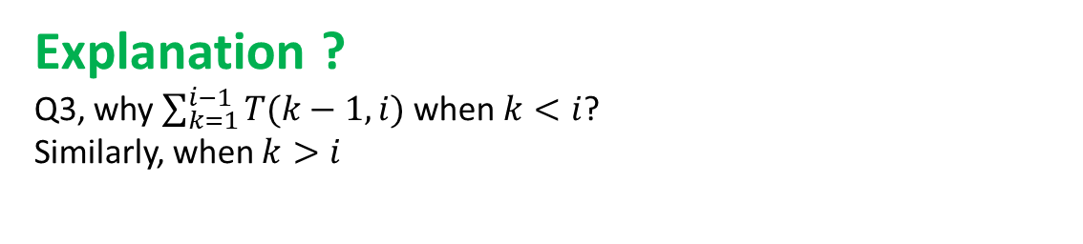
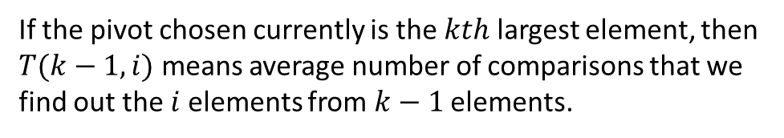

Random Selection
Explanation ?
Q3, why $\sum_{k=1}^{i−1}{T(k−1,i)}$ when $k<i$?
Similarly, when $k>i$
Postion: $1$ $i$ $k$ (Pivot) $n$
If the pivot chosen currently is the $kth$ largest element, then $T(k−1,i)$ means average number of comparisons that we find out the $i$elements from $k−1$ elements.

Slide 9
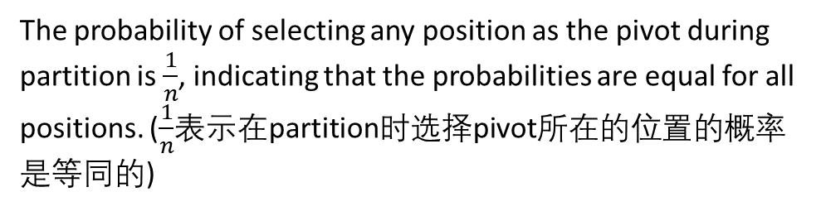
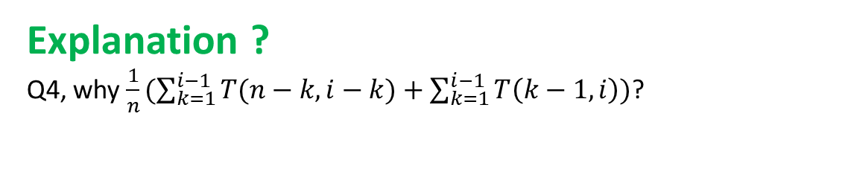
Random Selection
Explanation ?
Q4, why $\frac{1}{n}(\sum_{k=1}^{i−1}{T(n−k,i−k)}+\sum_{k=1}^{i−1}{T\left(k−1,i\right)})$?
The probability of selecting any position as the pivot during partition is $\frac{1}{n}$, indicating that the probabilities are equal for all positions. ($\frac{1}{n}$表示在partition时选择pivot所在的位置的概率是等同的)

Slide 10
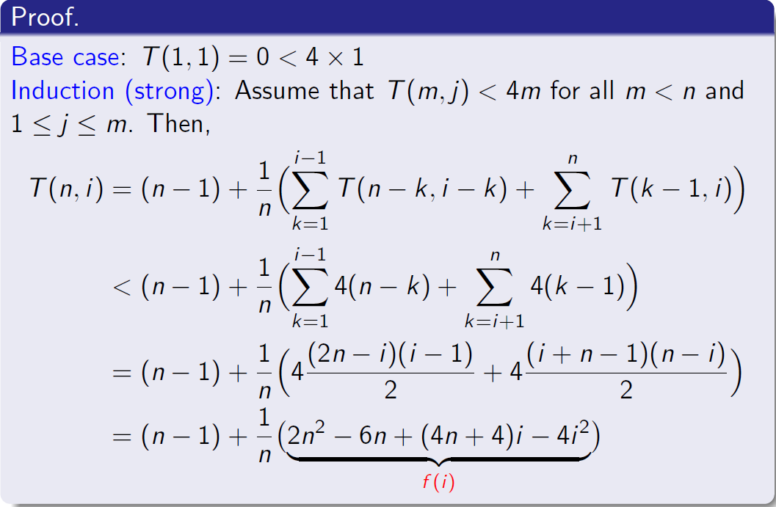
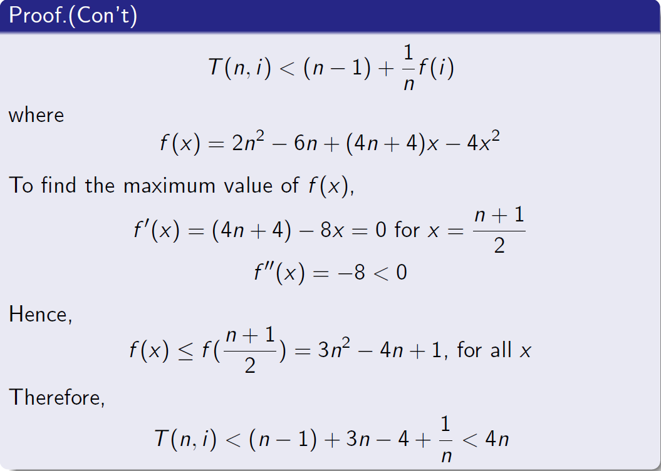

Random Selection
Prove the conclustion: $T(n,i)<4n$, for all $n>=i$ and $1≤i≤n$by mathematical induction.

